Slide 1
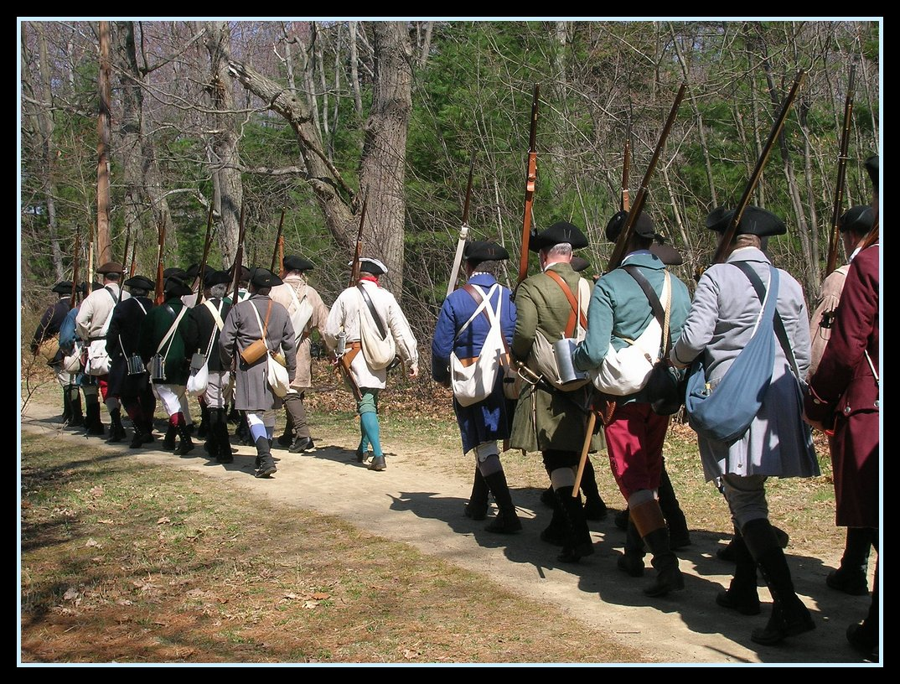
Road to Revolution…

Slide 2

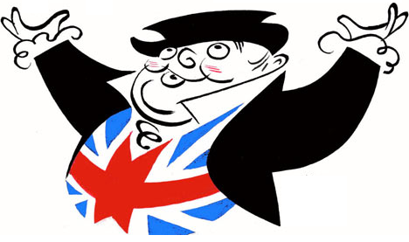
British Problems
KEEP CALM
AND
TAX THE COLONIES
A huge (£140 million, $33 billion today) debt from the French and Indian War, much of which was spent to protect the colonies.
Indians angry over perceived British insults and trespassing colonial settlers (Pontiac’s Rebellion).

Slide 3
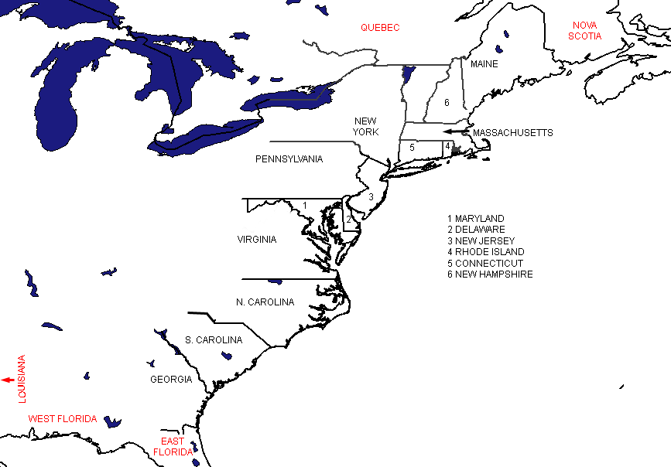
1763: Proclamation Line
INDIANS
Colonists are forbidden from settling west of the Appalachian Mountains; the land is reserved for Indians
Colonists move west anyway

Slide 4
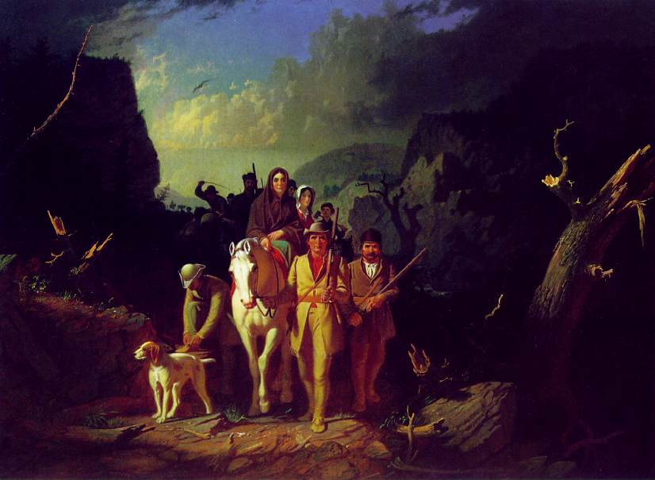
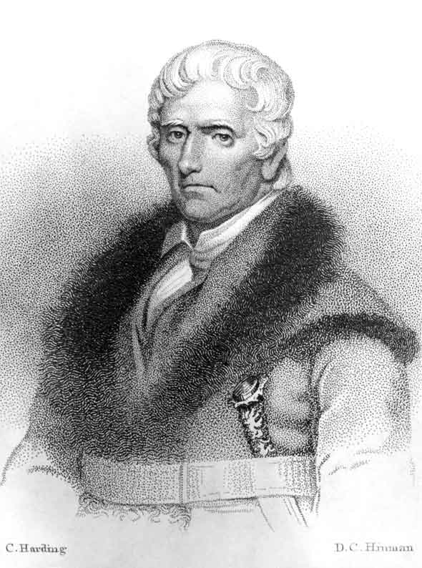

Slide 5
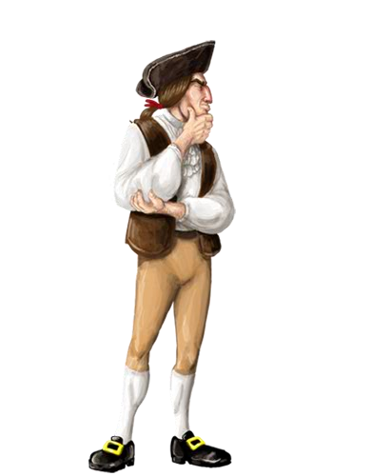
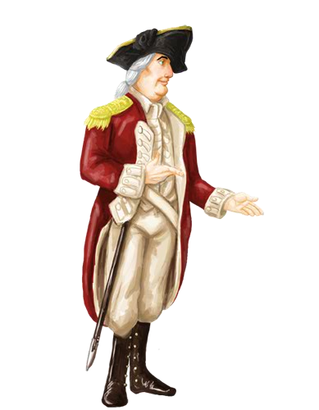
Only our colonial assemblies have the power to tax us!
If you want the money, ask us nicely!
Parliament has the power to tax anyone in the Empire, so pay up!

Slide 6
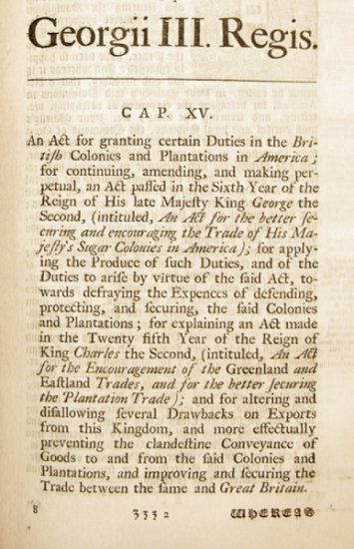

1764: Sugar Act
A new – lower- tax on sugar and molasses
Will be strictly enforced.

Slide 7
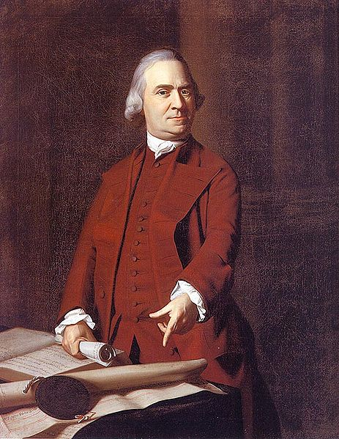
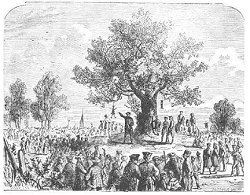
Reaction: Colonial protests begin
If our Trade may be taxed, why not our Lands? Why not the Produce of our Lands & everything we possess or make use of? This we apprehend annihilates our Charter Right to govern & tax ourselves. It strikes at our British privileges, which as we have never forfeited them, we hold in common with our Fellow Subjects who are Natives of Britain. If Taxes are laid upon us in any shape without our having a legal Representation where they are laid, are we not reduced from the Character of free Subjects to the miserable State of tributary Slaves?

Slide 8
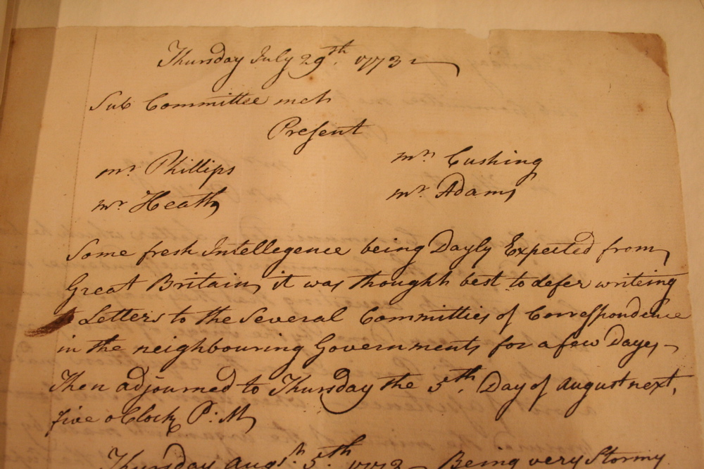
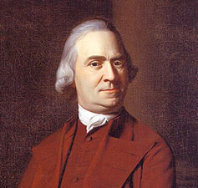
Committees of Correspondence: Beginning in Boston in 1764, started by colonial rebels to coordinate protest efforts and responses to Britain. By 1773 they served as shadow governments by rebel leaders.

Slide 9
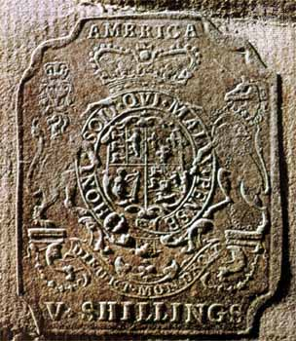
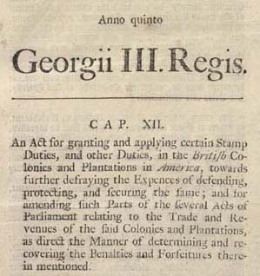
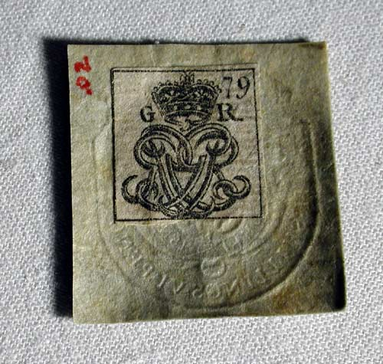
1765: Stamp Act
A tax on all paper, legal documents, newspapers, books, playing cards, etc
All paper must have a stamp on it that proves the tax has been paid

Slide 10
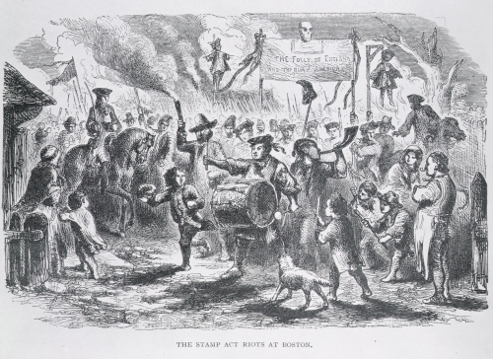
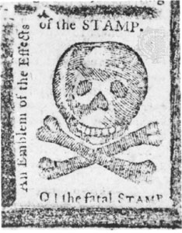
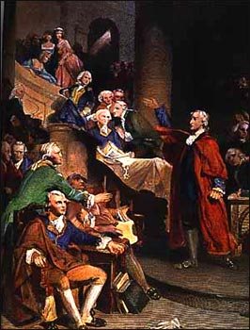
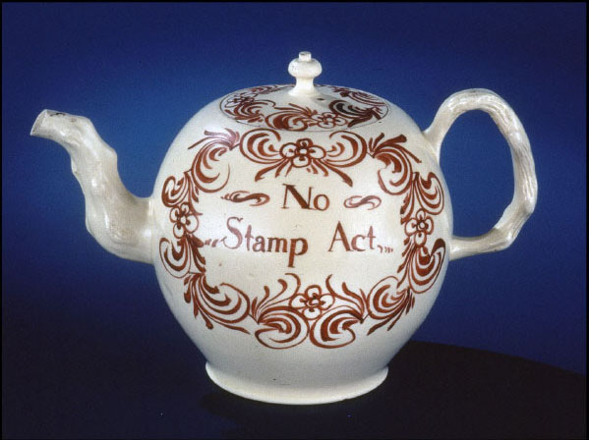
Reaction: Riots, attacks on British colonial officials, the Stamp Act Congress, boycotts

Slide 11
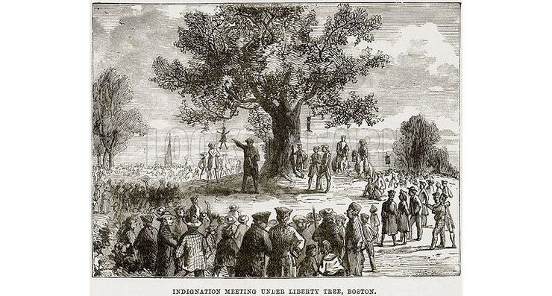
The Sons of Liberty: A secret organization, started in Boston, to organize protests against British taxation and the abridgement of English liberty in America.
Used protests, rallies, boycotts, but also mob violence.

Slide 12
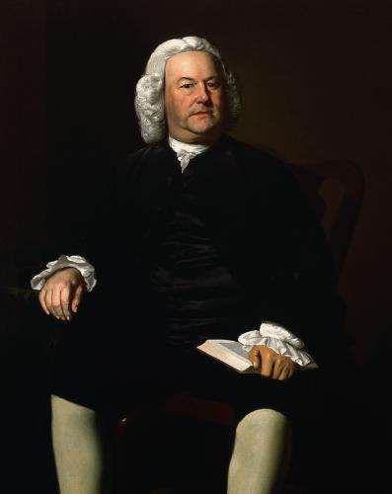
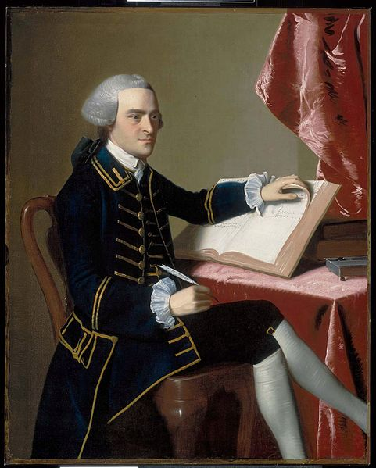
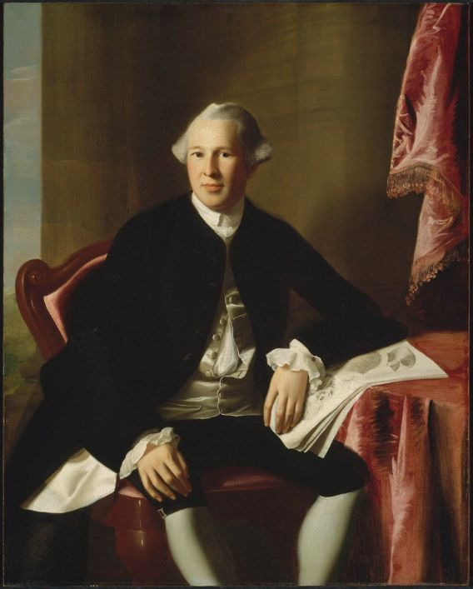
James Otis:
The Mouth
Sam Adams:
The Brains
John Hancock:
The Wallet
Joseph Warren:
The Figurehead

Slide 13
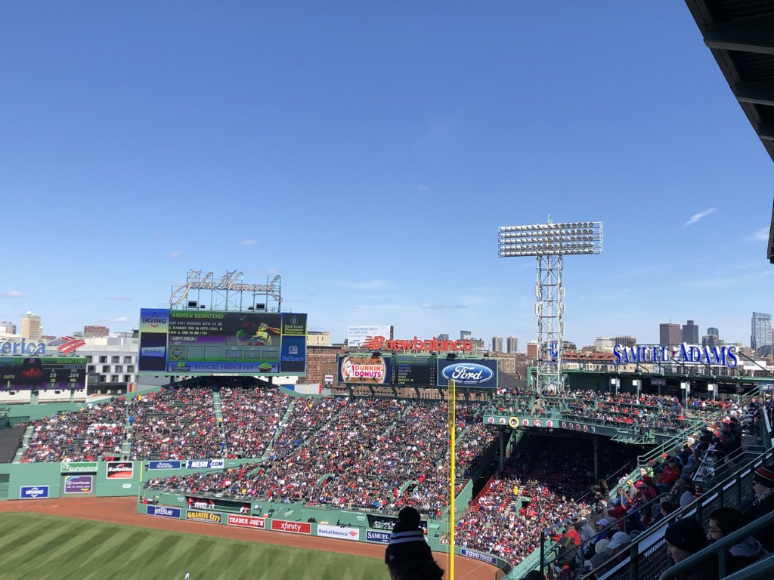

Slide 14

Stamp Act Congress: Meeting in New York City of representatives from 9 colonies to coordinate protests over the Stamp Act.
Declaration of Rights and Grievances: Document that contained colonial protests about the Stamp Act.
Colonists owed the Crown the same allegiance owed by other royal subjects
Colonist owed Parliament all due subordination
Colonists possessed all the rights of Englishmen
Trial by jury is a right
Use of Admiralty courts was abusive
Without voting rights, Parliament could not represent colonists
There should be no taxation without representation
Only colonial assemblies had the right to tax the colonies.

Slide 15
1765: Stamp Act
REPEALED - 1766
Declaratory Act - 1766
A tax on all paper, legal documents, newspapers, books, playing cards, etc
All paper must have a stamp on it that proves the tax has been paid
PS: We still have the right to tax you on whatever we want, whenever we please….

Slide 16

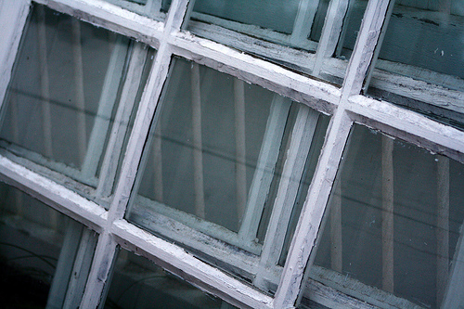

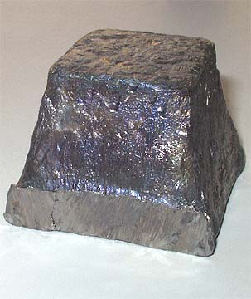
1767: Townshend Acts
A tax on glass, tea, paper, paint, lead, etc – mostly imported from England
Tax was paid in England
Designed to be a hidden tax, on luxury goods only the wealthy would ever purchase.

Slide 17
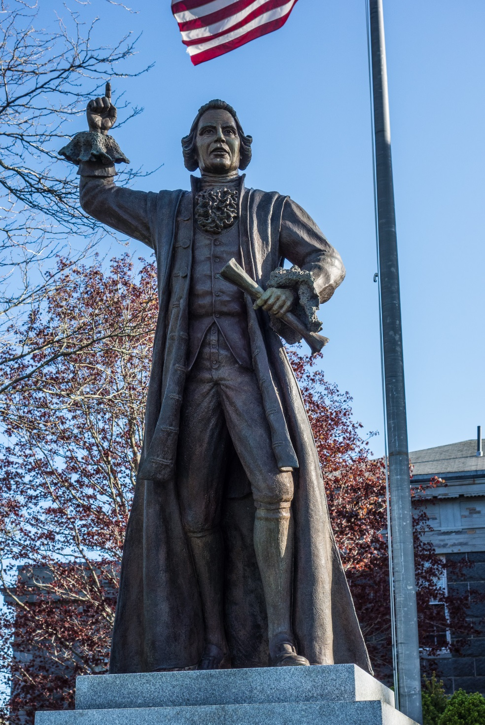
A man’s house is his
castle; and whilst he is quiet,
he is as well guarded as a prince in his castle. This writ, if it should be declared legal, would totally annihilate this privilege. Custom-house officers may enter our houses when they please; we are commanded to permit their entry. Their menial servants may enter, may break locks, bars, and everything in their way; and whether they break through malice or revenge, no man, no court may inquire.
Led to widespread use of “writs of assistance”: general search warrants that allowed officials to search shops, warehouses, ships, or private homes for smuggled goods for no given reason

Slide 18
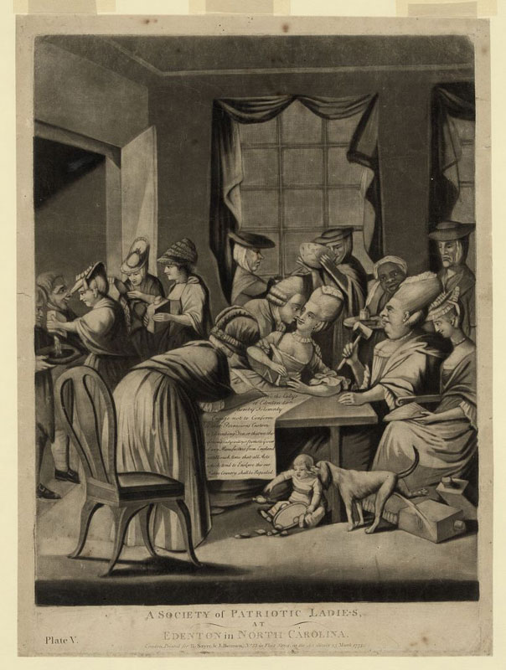
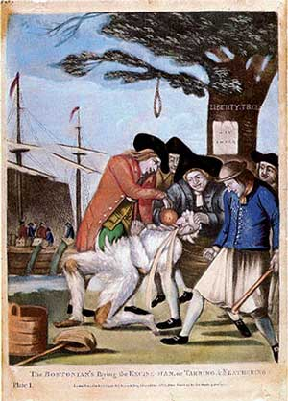
Reaction: Riots, protests, boycotts
(many led by women)

Slide 19
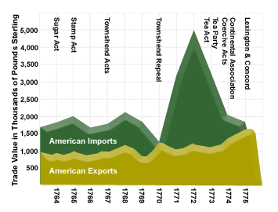

Slide 20
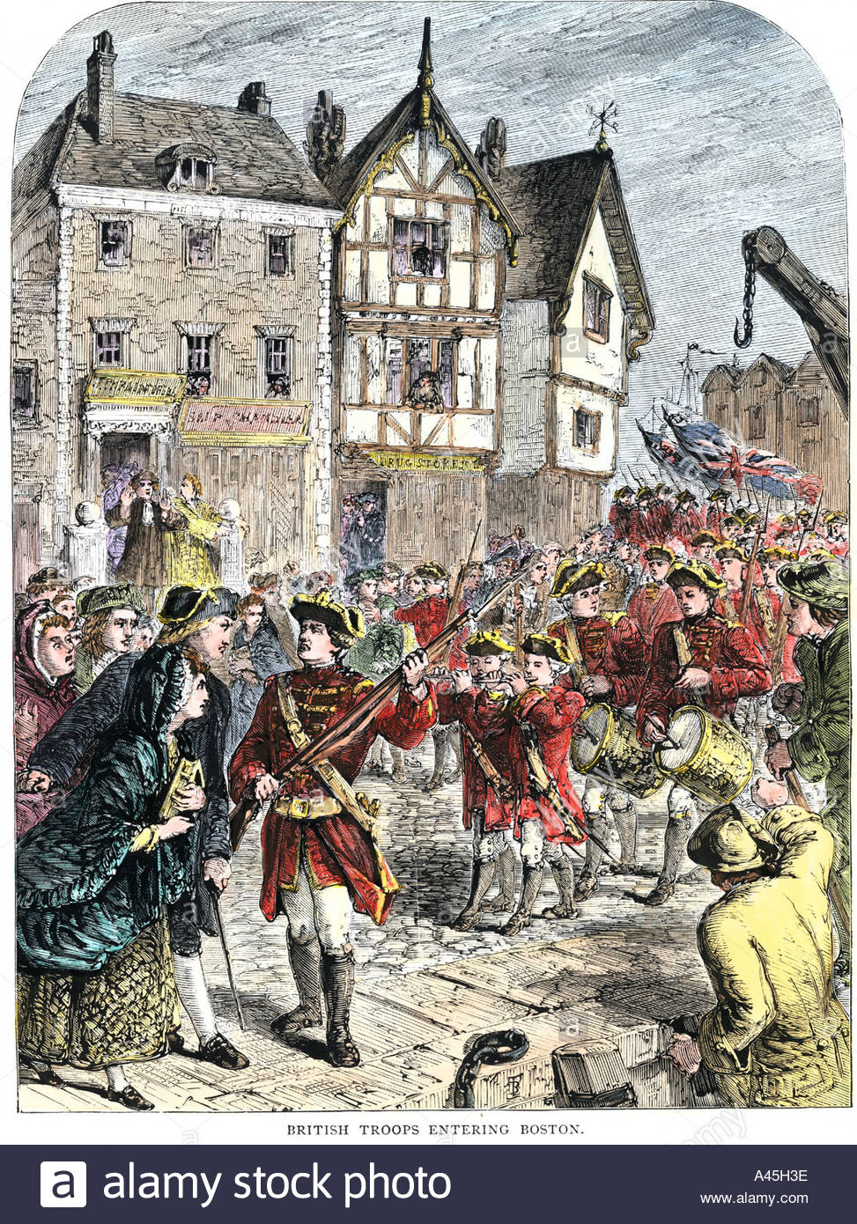

Massachusetts Circular Letter: 1768 Statement by Adams & Otis, approved by the MA government, restating the colonial position that Parliament could not tax the colonies, and that they had the right to tax themselves.
His Majesty’s American subjects, who acknowledge themselves bound by the ties of allegiance, have an equitable claim to the full enjoyment of the fundamental rules of the British constitution…that what a man has honestly acquired is absolutely his own, which he may freely give, but cannot be taken from him without his consent…It is, moreover, their humble opinion, which they express with the greatest deference to the wisdom of the Parliament, that the Acts made there, imposing duties on the people of this province, with the sole and express purpose of raising revenue, are infringements of their natural and constitutional rights; because they are not represented in the British Parliament, his Majesty’s Commons in Britain…
In response, the Royal Governor dismissed the MA assembly, and 4 regiment of troops were sent to occupy Boston.

Slide 21
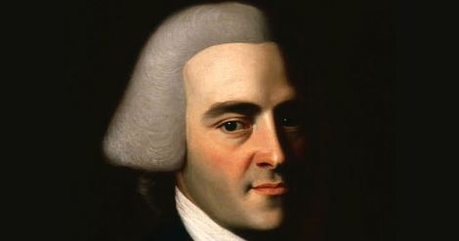
The Liberty Affair:
The Liberty, a ship owned by John Hancock, was seized by British officials on the suspicion that Hancock was smuggling taxed goods.
An angry mob attacked the British customs officials and drove them out of town.
Hancock was later cleared of the charges.

Slide 22
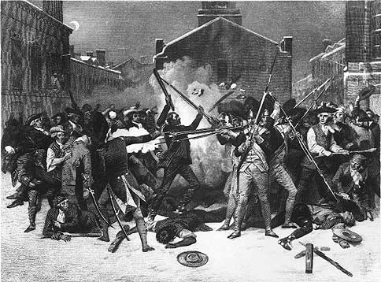
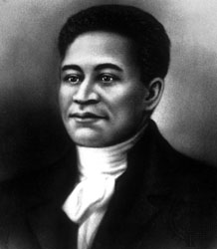
1770: “Boston Massacre”
British soldiers fire into a mob of rioting Bostonians, killing five

Slide 23
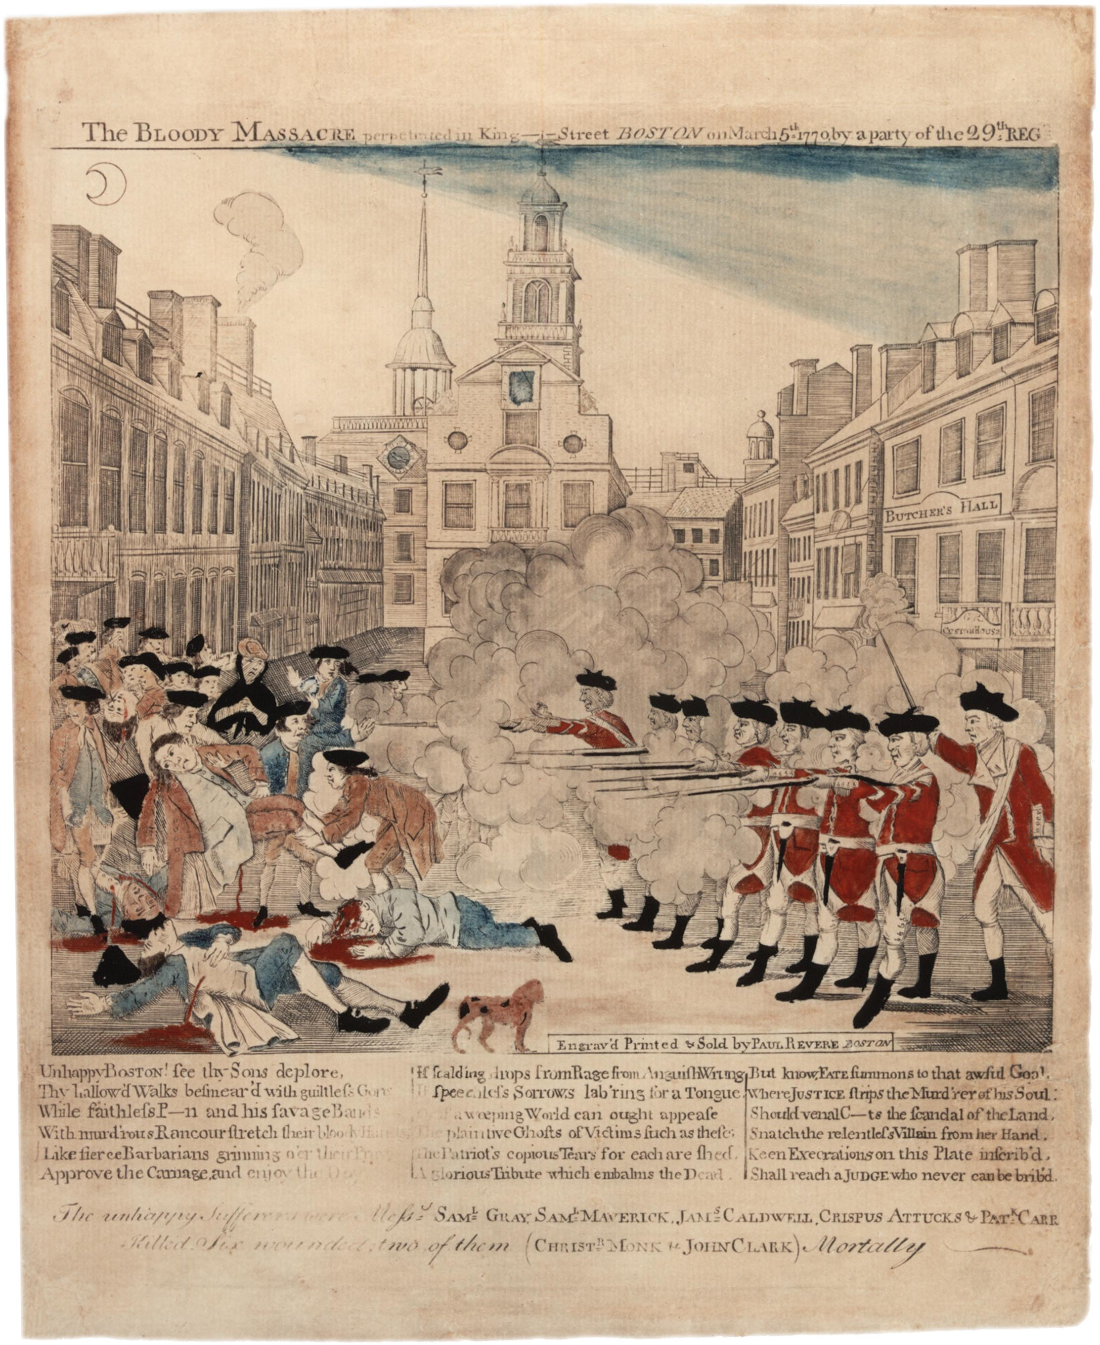

Slide 24
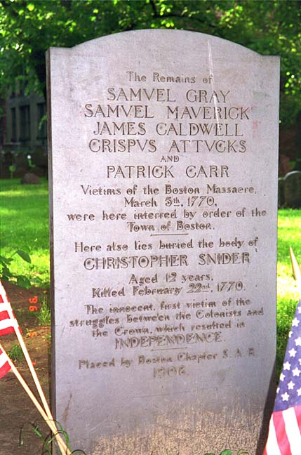
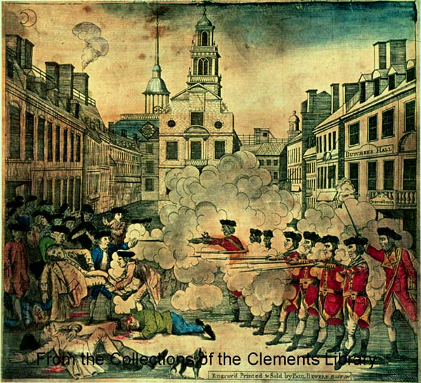
Reaction: Anti-British meetings across the colonies, propaganda spread through the Empire

Slide 25

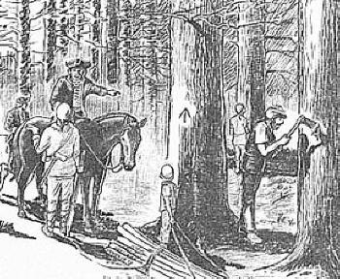
New Hampshire, 1772:
Pine Tree Riot

Slide 26
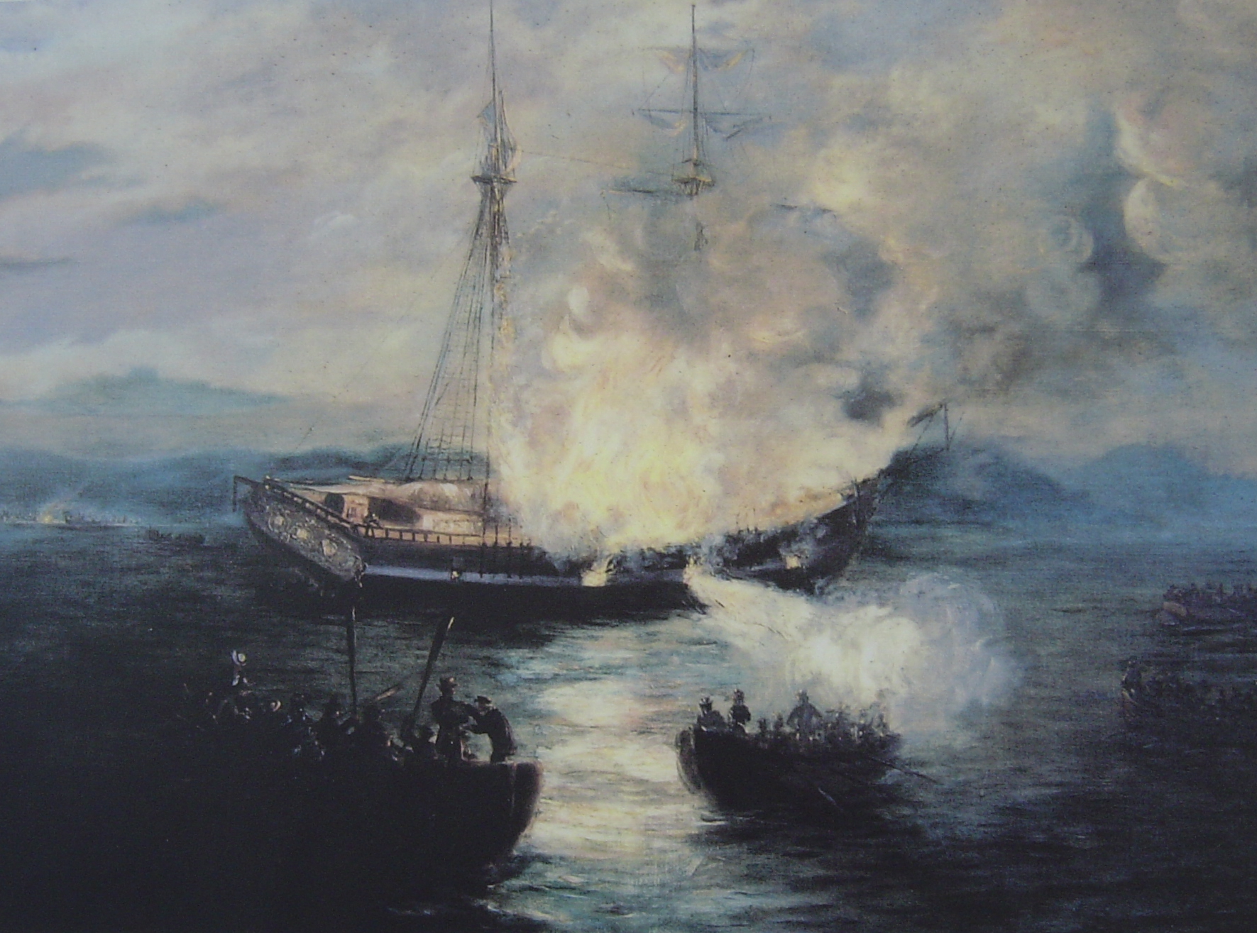
Rhode Island, 1772: Burning of the Gaspée

Slide 27
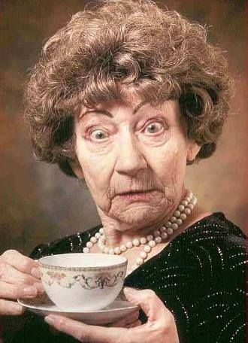
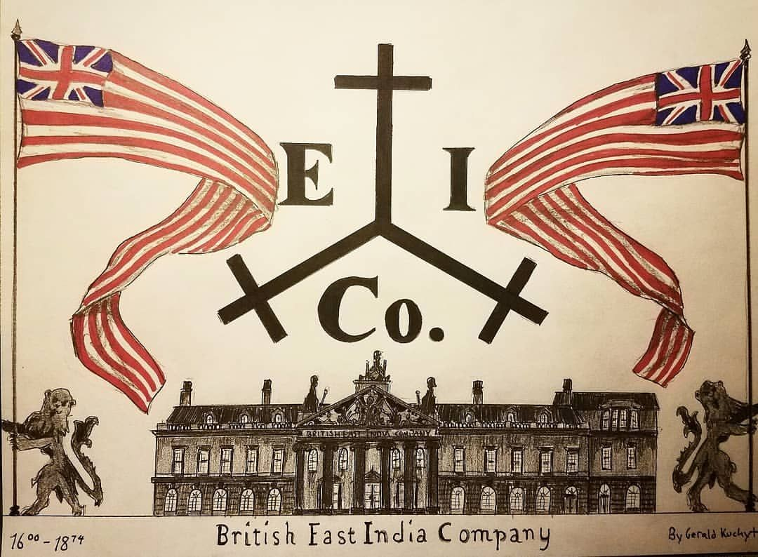
1773: Tea Act
Tax on tea is lowered, but is enforced; must be bought from the British East India Company

Slide 29
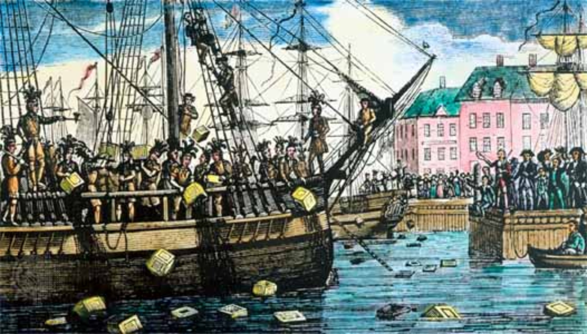
Reaction: Boston Tea Party
Boston Sons of Liberty throw 342 chests of tea into Boston Harbor (that’s 64 tons -18,523,000 cups of tea - over $1,000,000 in today’s money !)

Slide 30
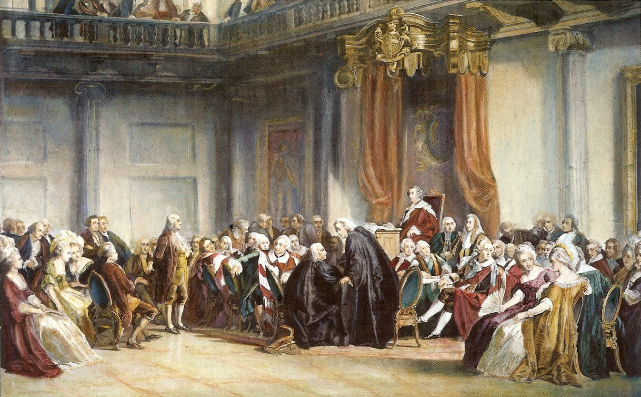
1773: Hutchinson Letters
Benjamin Franklin publishes damaging letters written by Massachusetts Governor Hutchinson, and is attacked in London.

Slide 31

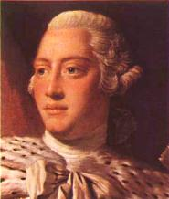
BRITAIN

Slide 32
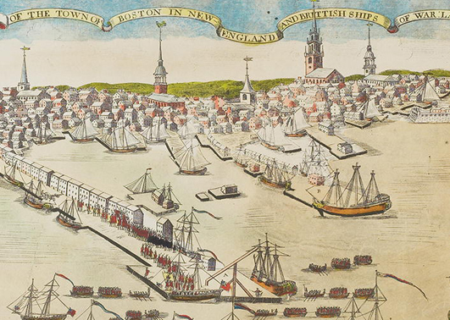

1774: Coercive/Intolerable Acts
1. Boston Port Act: closed until all tea is paid for – no ships in or out allowed.

Slide 33
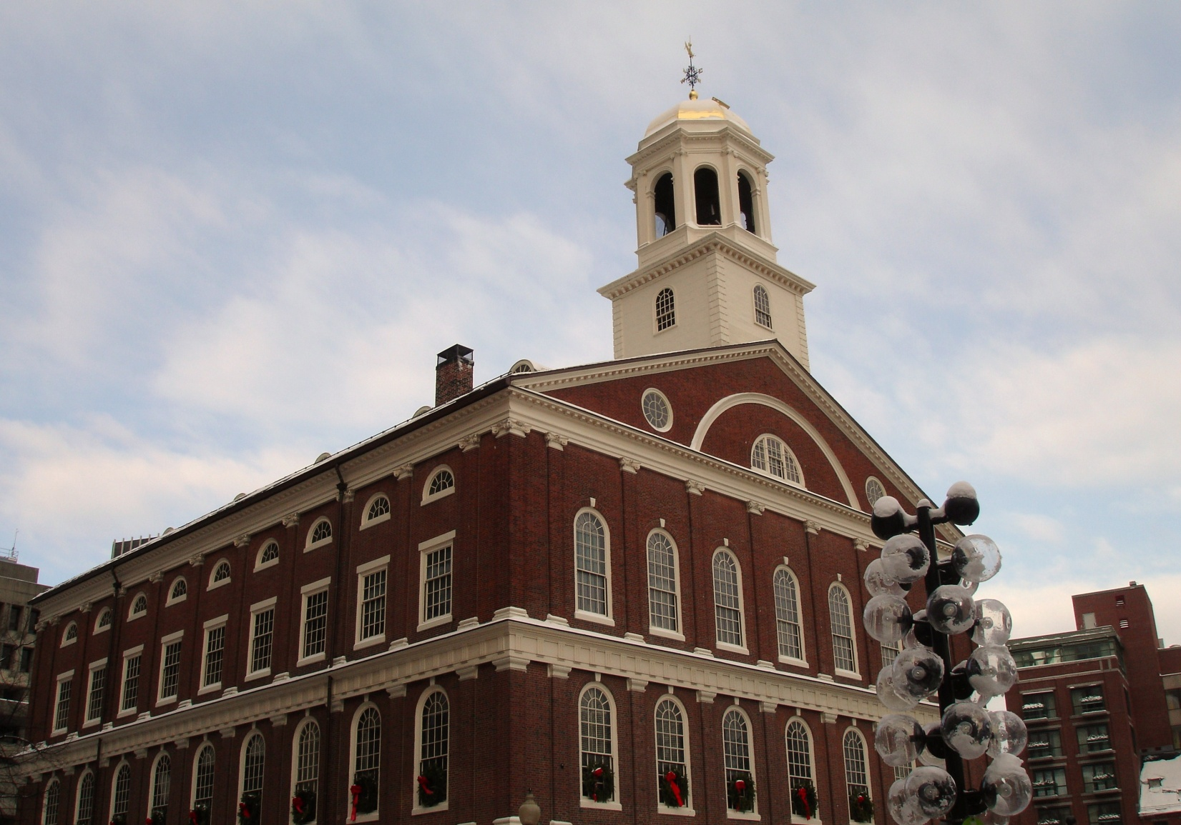
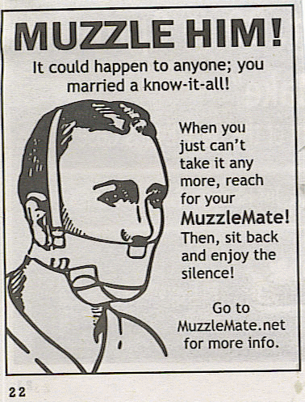
2. Massachusetts Government Act: Revoked the Massachusetts charter, colonial officials appointed by the crown, and only one town meeting per year.

Slide 34
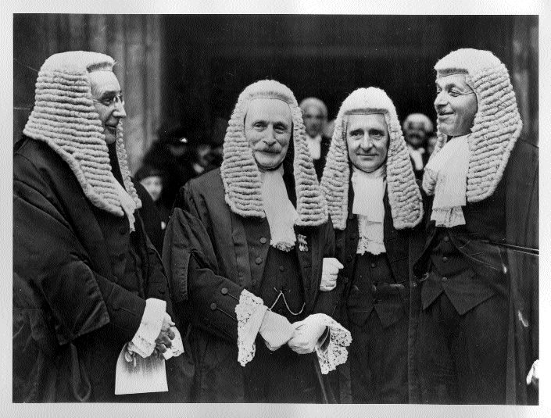
3. Administration of Justice Act: Trials of British officials will be conducted in England or Halifax, Nova Scotia. “The Murder Act”
Kind of a silly trial, really.
British officials never do anything wrong…
Clearly the defendant is not guilty…
Not guilty, yes, indeed…

Slide 35
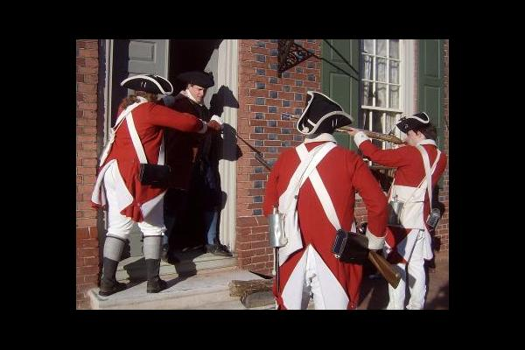
4. Quartering Act: Replacing the old act, colonies are not only compelled to provide housing for British troops, but they may be housed in privately owned buildings if necessary.
You got any food?
We’re moving into the living room!
And there’s nothing you can do about it!

Slide 36
1774: Quebec Act*
Boundary of Quebec is extended, French civil laws put in place, and French Catholics are granted freedom of religion.
* Not, technically, one of the Coercive Acts

Slide 37
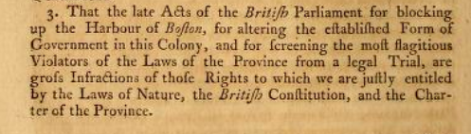
The Suffolk Resolves
Document issued by Suffolk County, Massachusetts (Boston)
Denounced the Intolerable Acts and vowed to disobey them
Demanded royally appointed officials to resign
Refused to pay taxes until Acts were repealed
Demanded a colonial government free of royal authority
Urged the colonies to raise militias

Slide 38


First Continental Congress
-Meeting in Philadelphia of 12 colonies in response to the Intolerable Acts
Did not agree to unite the colonies, but:
-Created the Continental Association, which resolved to boycott British goods
-Wrote the Declaration and Resolves, a list of objections to the Intolerable Acts
-Agreed to meet in 1 year if no improvements

